Slide 1

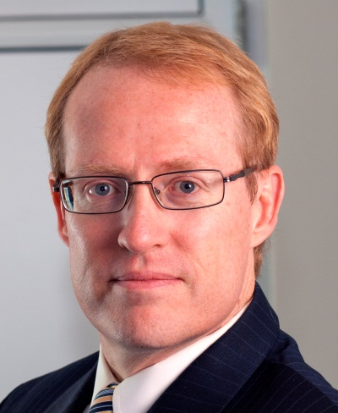
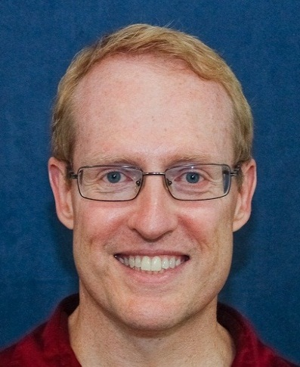
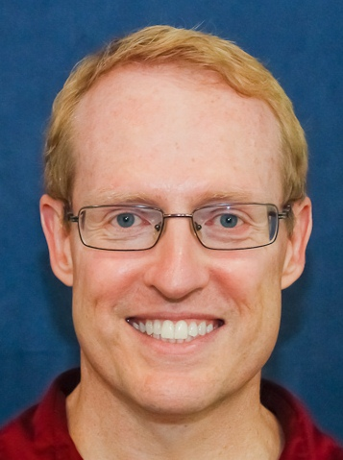

Benefits & Limitations of Patterns & Frameworks: Part 1
Douglas C. Schmidt
d.schmidt@vanderbilt.edu
www.dre.vanderbilt.edu/~schmidt
Professor of Computer Science
Institute for Software Integrated Systems Vanderbilt University Nashville, Tennessee, USA

Slide 2

Topics Covered in this Part of the Module
Summarize the benefits & limitations of patterns
Notes:
http://upload.wikimedia.org/wikiversity/en/c/c7/Mask.gif

Slide 3
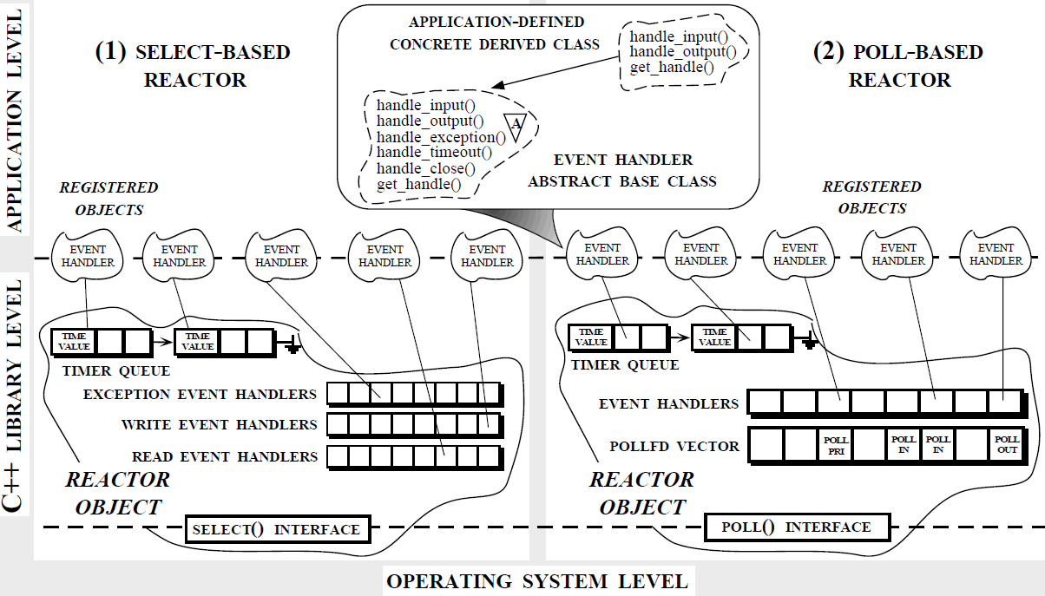
Benefits of Patterns
Capture & abstract recurring software roles & relationships to facilitate systematic reuse of successful designs
(1) SELECT-BASED REACTOR
(2) POLL-BASED REACTOR
See www.dre.vanderbilt.edu/~schmidt/PDF/Reactor2-93.pdf for more info
Notes:
Origins of the Reactor story.

Slide 4
Benefits of Patterns
Capture & abstract recurring software roles & relationships to facilitate systematic reuse of successful designs
Event Handler
Reactor
*
handle_events()
register_handler()
remove_handler()
dispatches
handle_event()
get_handle()
*
Handle
owns
*
notifies
<<uses>>
handle set
Synchronous
Event Demuxer
Concrete Event Handler A
select()
handle_event()
get_handle()
(1) SELECT-BASED REACTOR
Concrete Event Handler B
handle_event()
get_handle()
See www.dre.vanderbilt.edu/~schmidt/PDF/Reactor.pdf for more info
Notes:
Origins of the Reactor story.

Slide 5

Benefits of Patterns
Capture & abstract recurring software roles & relationships to facilitate systematic reuse of successful designs
Record engineering tradeoffs & design alternatives to enhance development & sustainment

Slide 6
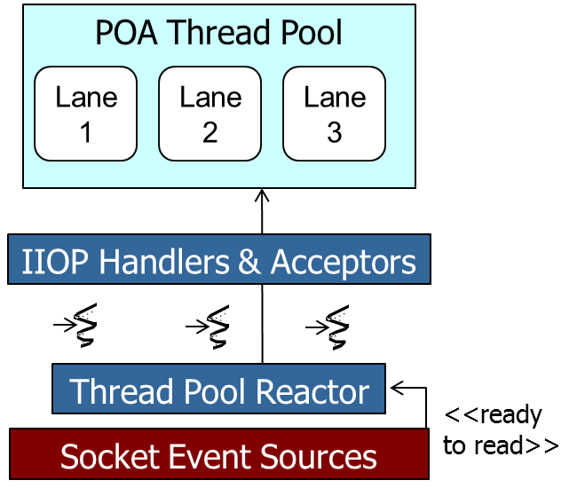
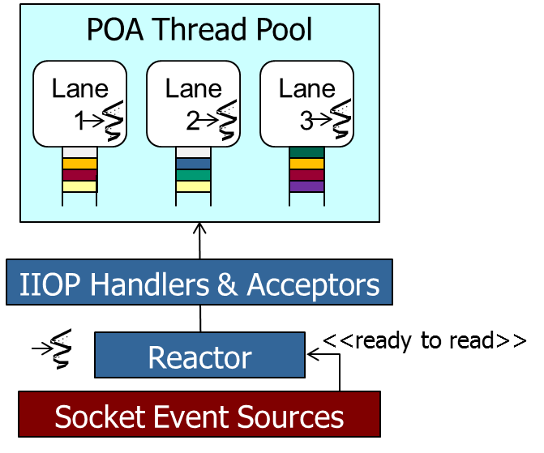
Benefits of Patterns
Capture & abstract recurring software roles & relationships to facilitate systematic reuse of successful designs
Record engineering tradeoffs & design alternatives to enhance development & sustainment
Leader/ Followers
model
Tradeoff Analysis | Leader/ Followers | Half-Sync/ Half-Async
Features | Poor | Good
Scalability | Poor | Good
Efficiency | Good | Poor
Optimizations | Good | Poor
Priority inversion | Good | Poor
Half-Sync/ Half-Async model
See www.dre.vanderbilt.edu/~schmidt/PDF/OM-01.pdf for more info

Slide 7
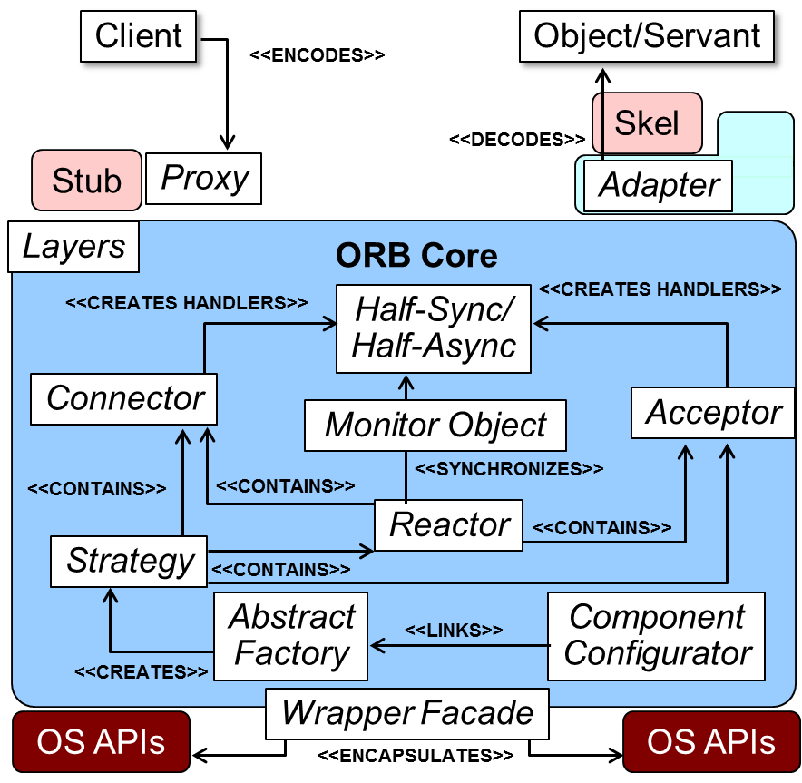
Benefits of Patterns
Capture & abstract recurring software roles & relationships to facilitate systematic reuse of successful designs
Record engineering tradeoffs & design alternatives to enhance development & sustainment
Enable a shared design vocabulary that enhances understanding, (re)engineering effort, & team communication
See www.dre.vanderbilt.edu/~schmidt/corba-research-design.html for more
Notes:
Tell Hardpack story

Slide 8

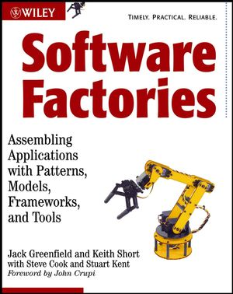
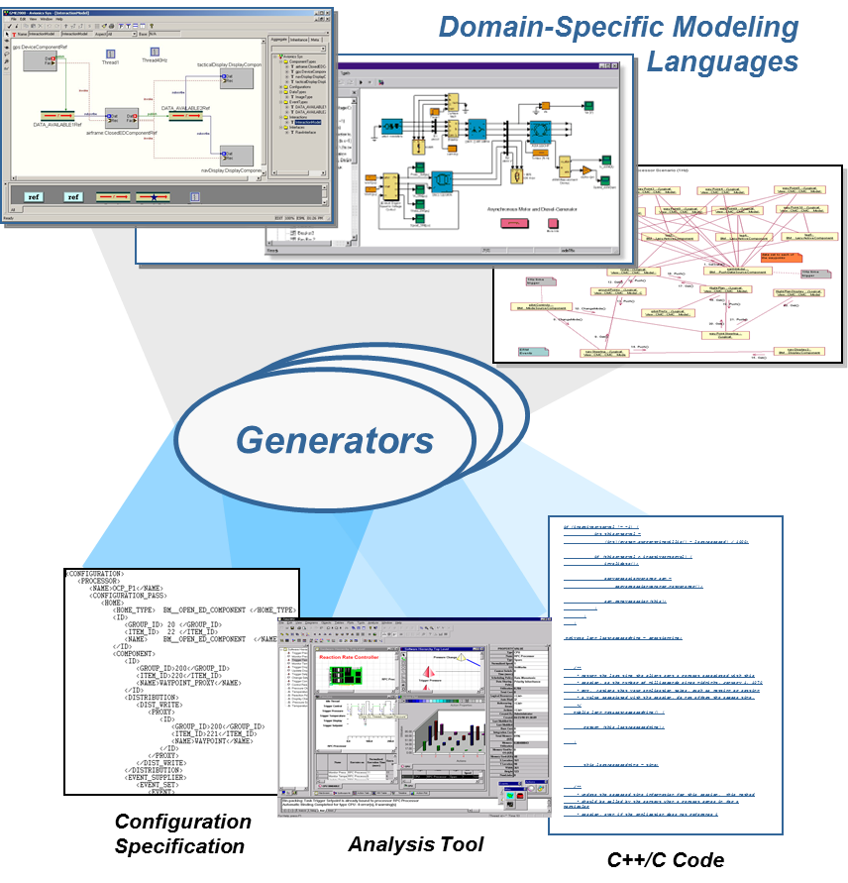
Benefits of Patterns
Capture & abstract recurring software roles & relationships to facilitate systematic reuse of successful designs
Record engineering tradeoffs & design alternatives to enhance development & sustainment
Enable a shared design vocabulary that enhances understanding, (re)engineering effort, & team communication
Provide a basis for automation
See www.dre.vanderbilt.edu/~schmidt/GEI.pdf for more info
Notes:
Retell Proxy story briefly

Slide 9

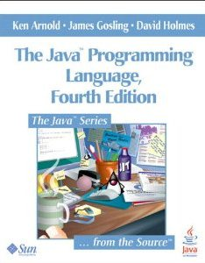
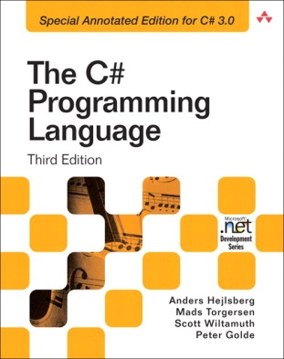
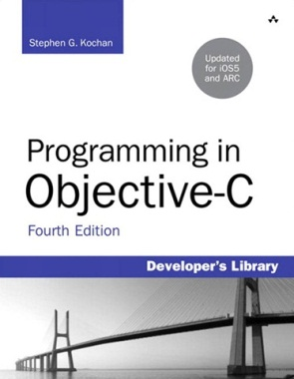

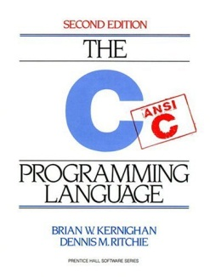
Benefits of Patterns
Capture & abstract recurring software roles & relationships to facilitate systematic reuse of successful designs
Record engineering tradeoffs & design alternatives to enhance development & sustainment
Enable a shared design vocabulary that enhances understanding, (re)engineering effort, & team communication
Provide a basis for automation
Transcend language-centric biases
Notes:
http://www.flickr.com/photos/55510802@N06/5422730118/

Slide 10

Benefits of Patterns
Capture & abstract recurring software roles & relationships to facilitate systematic reuse of successful designs
Record engineering tradeoffs & design alternatives to enhance development & sustainment
Enable a shared design vocabulary that enhances understanding, (re)engineering effort, & team communication
Provide a basis for automation
Transcend language-centric biases
Abstract away from non-essential implementation details
e.g., during the design phase
Reactor
*
Event Handler
handle_events()
register_handler()
remove_handler()
dispatches
handle_event ()
get_handle()
*
Handle
owns
*
notifies
<<uses>>
handle set
Synchronous
Event Demuxer
Concrete Event Handler A
select ()
handle_event ()
get_handle()
Concrete Event Handler B
handle_event ()
get_handle()
Notes:
http://www.flickr.com/photos/55510802@N06/5422730118/

Slide 11

Limitations of Patterns
Significant tedious & error-prone human effort may be needed to implement patterns manually
Thread Pool
demultiplexes
synchronizer
join()
promote_new_leader()
*
Event Handler
Handle
uses
handle_event ()
get_handle()
*
Handle Set
handle_events()
deactivate_handle()
reactivate_handle()
select()
Concrete Event Handler B
handle_event ()
get_handle()
Leader/ Followers pattern
Concrete Event Handler A
handle_event ()
get_handle()
See www.dre.vanderbilt.edu/~schmidt/PDF/LF.pdf for more info
Notes:
http://en.wikipedia.org/wiki/File:Punishment_sisyph.jpg

Slide 12
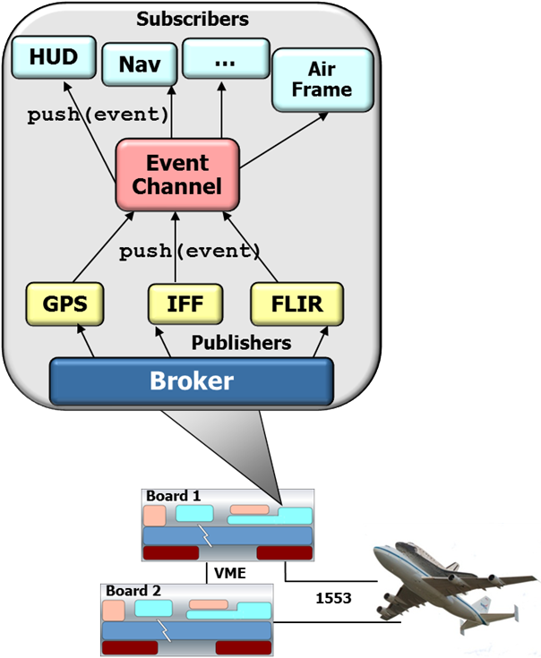
Limitations of Patterns
Significant tedious & error-prone human effort may be needed to implement patterns manually
Shared design vocabulary can be deceptively simple
Notes:
Tell how hard it was to keep sponsors engaged once they realized that we were implementing common patterns & standards-based middleware.

Slide 13
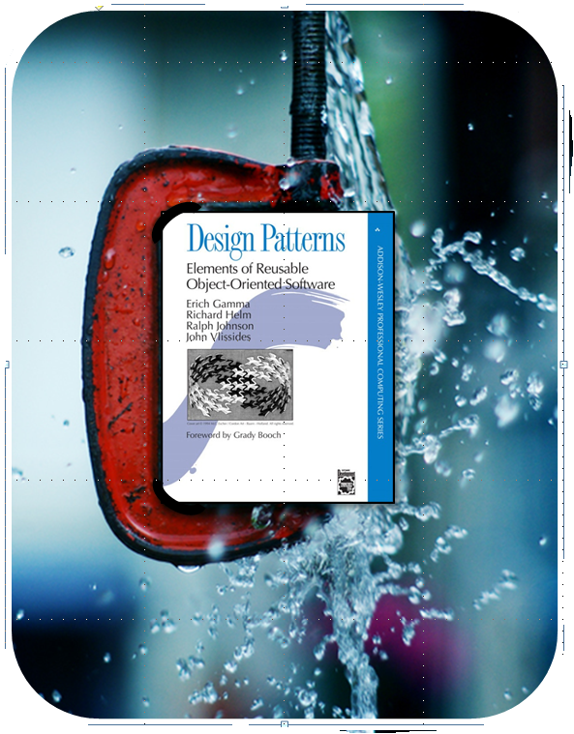
Limitations of Patterns
Significant tedious & error-prone human effort may be needed to implement patterns manually
Shared design vocabulary can be deceptively simple
Limited knowledge of patterns can constrain design options
Notes:
http://www.flickr.com/photos/11419506@N08/2615423250/

Slide 14

Limitations of Patterns
Reactor
*
Event Handler
Significant tedious & error-prone human effort may be needed to implement patterns manually
Shared design vocabulary can be deceptively simple
Limited knowledge of patterns can constrain design options
Essential implementation & optimization details may be neglected
e.g., edge-triggered vs. level-triggered event demuxers
handle_events()
register_handler()
remove_handler()
dispatches
handle_event ()
get_handle()
*
Handle
owns
*
notifies
<<uses>>
handle set
Synchronous
Event Demuxer
Concrete Event Handler A
select ()
handle_event ()
get_handle()
Concrete Event Handler B
handle_event ()
get_handle()
See www.kernel.org/doc/man-pages/online/pages/man4/epoll.4.html for more
Notes:
http://www.flickr.com/photos/75001512@N00/4864207213/

Slide 15

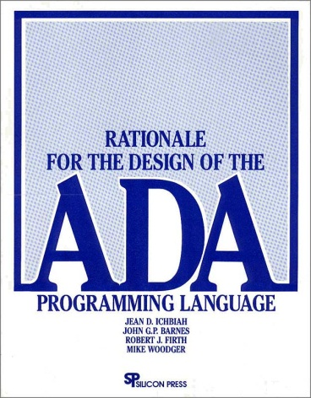
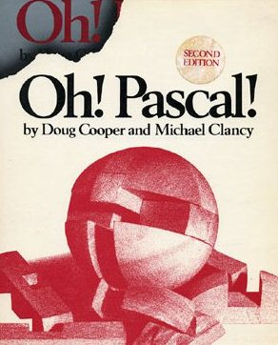

Limitations of Patterns
Significant tedious & error-prone human effort may be needed to implement patterns manually
Shared design vocabulary can be deceptively simple
Limited knowledge of patterns can constrain design options
Essential implementation & optimization details may be neglected
Not all patterns are applicable to non-object-oriented languages
Nor are they always applicable in the same way

Slide 16
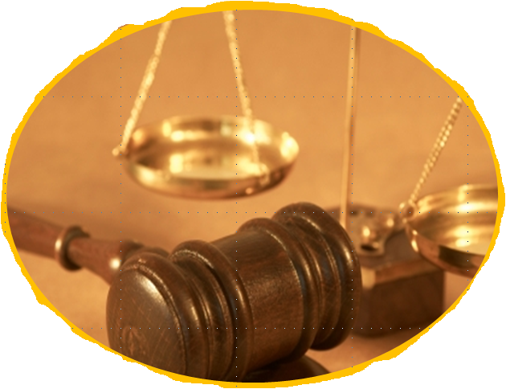
Summary
The goal of patterns is not to replace developer creativity with rote application of rigid design rules & coding laws
Notes:
http://www.flickr.com/photos/controlarms/5861481206/sizes/o/

Slide 17

Summary
The goal of patterns is not to replace developer creativity with rote application of rigid design rules & coding laws
Nor is the goal to replace huamans with automated tools
Notes:
http://www.flickr.com/photos/87204754@N00/3061093760/

Slide 18

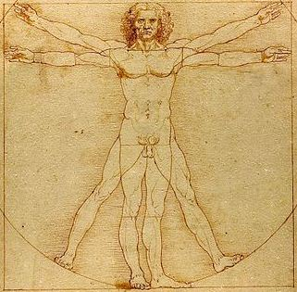
Summary
The goal of patterns is not to replace developer creativity with rote application of rigid design rules & coding laws
Nor is the goal to replace humans with automated tools
Instead, the goal is to codify important human insights & experience associated with developing software
Notes:
http://en.wikipedia.org/wiki/File:Da_Vinci_Vitruve_Luc_Viatour.jpg

Slide 19
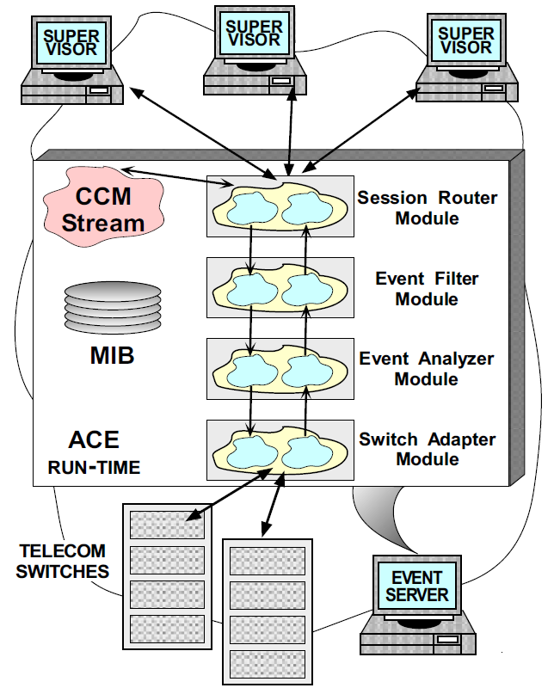
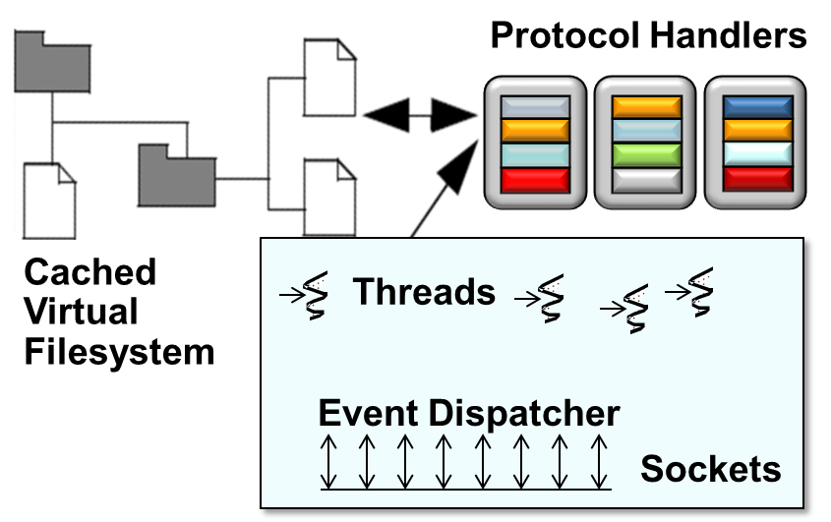
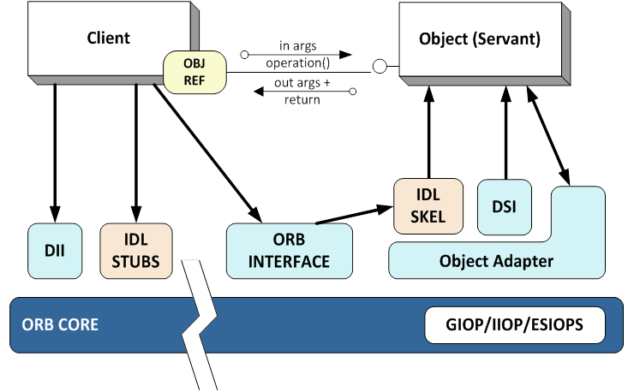
Summary
The goal of patterns is not to replace developer creativity with rote application of rigid design rules & coding laws
Nor is the goal to replace humans with automated tools
Instead, the goal is to codify important human insights & experience associated with developing software
Good patterns arise by generalizing from practical experience
See www.dre.vanderbilt.edu/~schmidt/patterns-experience.html for more info

Slide 20
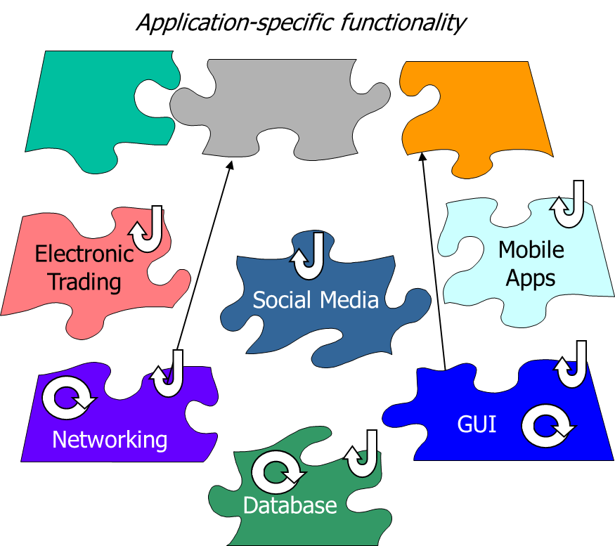
Summary
The goal of patterns is not to replace developer creativity with rote application of rigid design rules & coding laws
Nor is the goal to replace humans with automated tools
Instead, the goal is to codify important human insights & experience associated with developing software
Good patterns arise by generalizing from practical experience
Addressing key limitations of patterns requires more than just design reuse

Slide 21
Benefits & Limitations of Patterns & Frameworks: Part 2
Douglas C. Schmidt
d.schmidt@vanderbilt.edu
www.dre.vanderbilt.edu/~schmidt
Professor of Computer Science
Institute for Software Integrated Systems Vanderbilt University Nashville, Tennessee, USA

Slide 22

Topics Covered in this Part of the Module
Summarize the benefits & limitations of patterns
Summarize the benefits & limitations of frameworks
Notes:
3D Scales of Justice, http://www.flickr.com/photos/86530412@N02/7953227784/

Slide 23
Benefits of Frameworks
Design reuse
e.g., by guiding app developers thru steps needed to ensure successful creation & deployment of software
See www.dre.vanderbilt.edu/~schmidt/PDF/ORB-patterns.pdf for more info

Slide 24
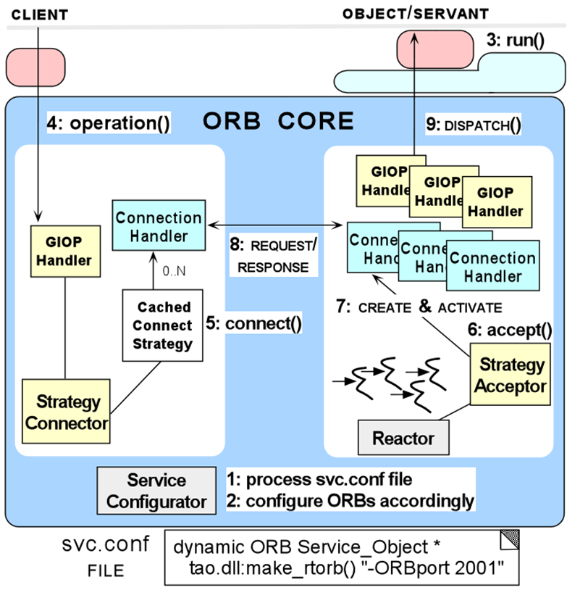
Benefits of Frameworks
Design reuse
e.g., by guiding app developers thru steps needed to ensure successful creation & deployment of software
Implementation reuse
e.g., by leveraging previous development & optimization efforts & amortizing software lifecycle costs
See www.dre.vanderbilt.edu/~schmidt/PDF/ORB-patterns.pdf for more info

Slide 25
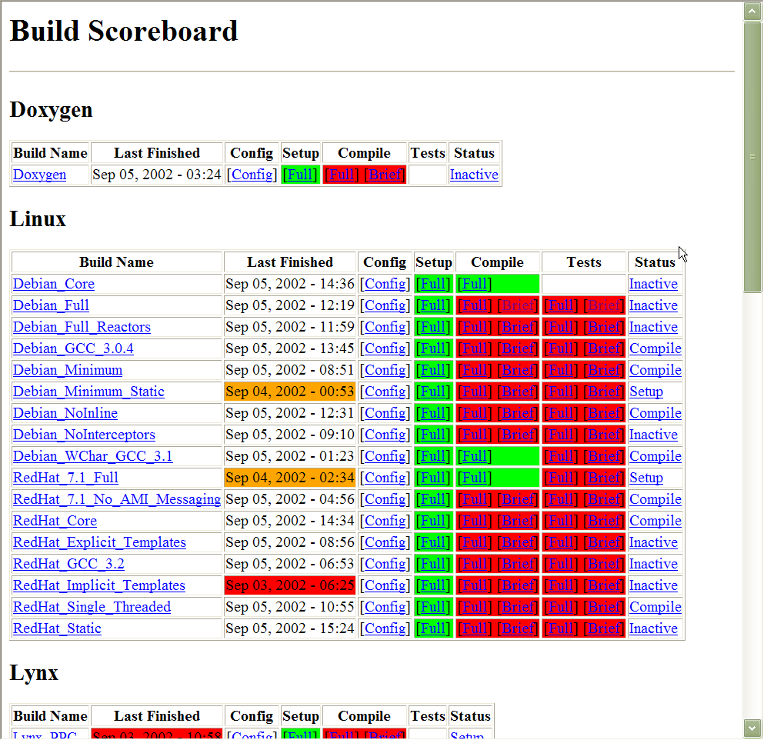
Benefits of Frameworks
Design reuse
e.g., by guiding app developers thru steps needed to ensure successful creation & deployment of software
Implementation reuse
e.g., by leveraging previous development & optimization efforts & amortizing software lifecycle costs
Validation reuse
e.g., by amortizing the efforts of validating application- & platform-independent portions of software, thereby enhancing dependability & performance
www.dre.vanderbilt.edu/scoreboard

Slide 26
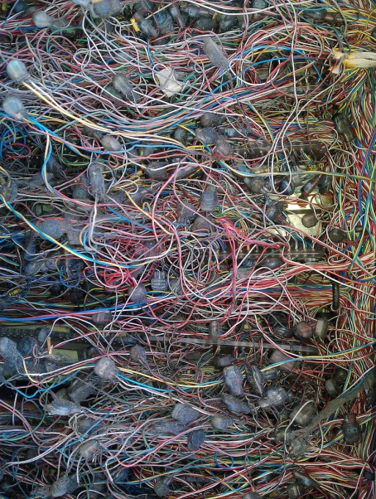
Limitations of Frameworks
Frameworks are powerful, but many app developers find them hard to create/use effectively
Notes:
http://www.flickr.com/photos/48001773@N00/7670055210/

Slide 27
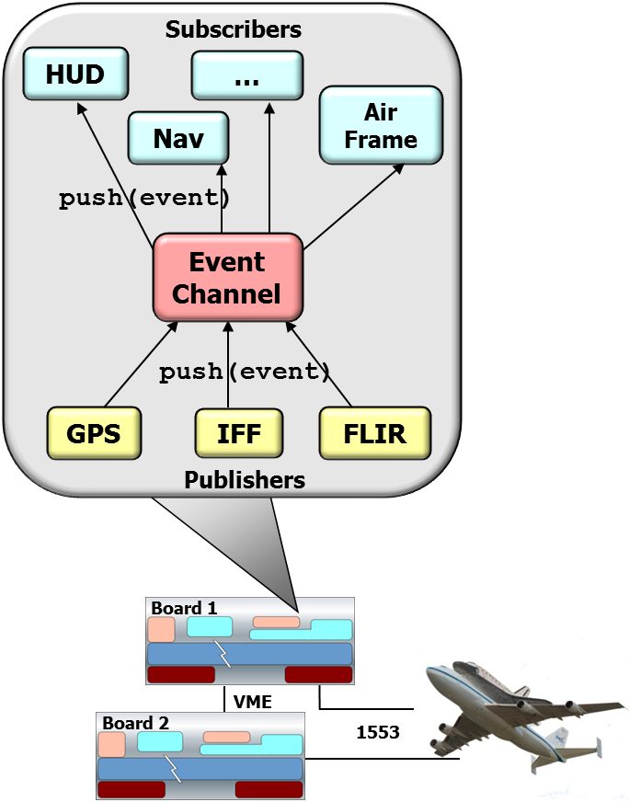
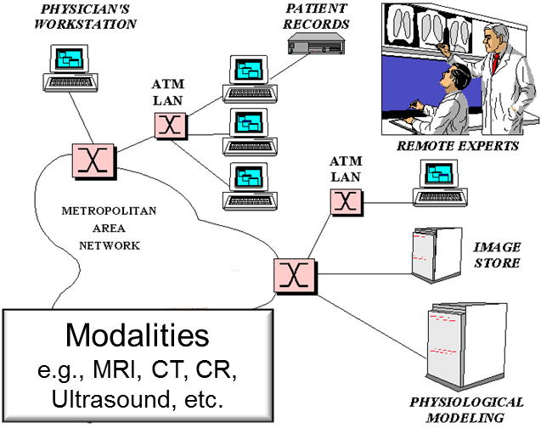
Limitations of Frameworks
Frameworks are powerful, but many app developers find them hard to create/use effectively
Scope/Commonality/Variability analysis requires significant domain knowledge & reusable software development expertise
Notes:
http://www.flickr.com/photos/48001773@N00/7670055210/

Slide 28
Limitations of Frameworks
Frameworks are powerful, but many app developers find them hard to create/use effectively
Scope/Commonality/Variability analysis requires significant domain knowledge & reusable software development expertise
Developing frameworks in non-OO languages is even harder
static int cmpstrs (const void *p1, const void *p2)
{ return strcmp (*(char* const*) p1, * (char* const*) p2); }
static int casecmpstrs (const void *p1, const void *p2)
{ return strcasecmp (*(char* const*) p1, * (char* const*) p2); }
int main(int argc, char *argv[]) {
int j, icase = *argv[1] == ’i’;
qsort (&argv[2], argc - 1, sizeof(char *), icase ? casecmpstrs : cmpstrs);
for (j = 2; j < argc; ++j) puts(argv[j]);
}
Strategy pattern
Notes:
http://www.flickr.com/photos/48001773@N00/7670055210/

Slide 29
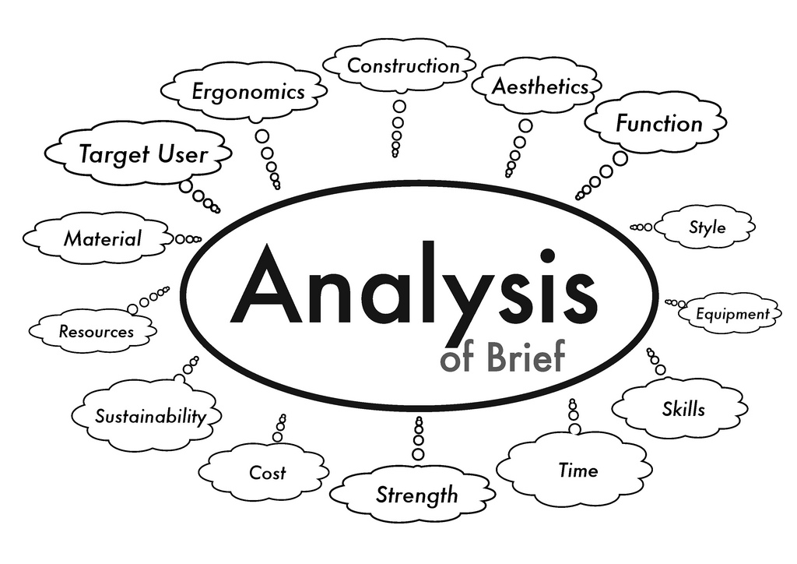
Limitations of Frameworks
Frameworks are powerful, but many app developers find them hard to create/use effectively
Scope/Commonality/Variability analysis requires significant domain knowledge & reusable software development expertise
Developing frameworks in non-OO languages is even harder
Significant time required to evaluate applicability & quality of a framework for a particular domain
Notes:
http://www.flickr.com/photos/42042252@N02/4086095092/

Slide 30

Limitations of Frameworks
Frameworks are powerful, but many app developers find them hard to create/use effectively
Scope/Commonality/Variability analysis requires significant domain knowledge & reusable software development expertise
Developing frameworks in non-OO languages is even harder
Significant time required to evaluate applicability & quality of a framework for a particular domain
Inversion of control makes debugging tricky
Notes:
http://www.flickr.com/photos/76103695@N00/1703252007/

Slide 31
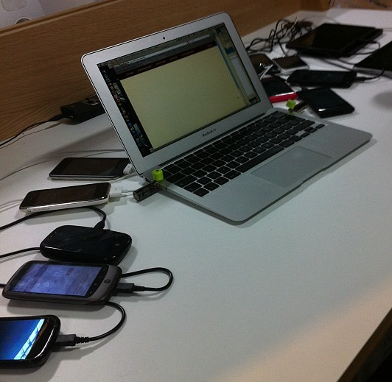
Limitations of Frameworks
Frameworks are powerful, but many app developers fine them hard to create/use effectively
Scope/Commonality/Variability analysis requires significant domain knowledge & reusable software development expertise
Developing frameworks in non-OO languages is even harder
Significant time required to evaluate applicability & quality of a framework for a particular domain
Inversion of control makes debugging tricky
Testing can be tricky due to “late binding”

Slide 32
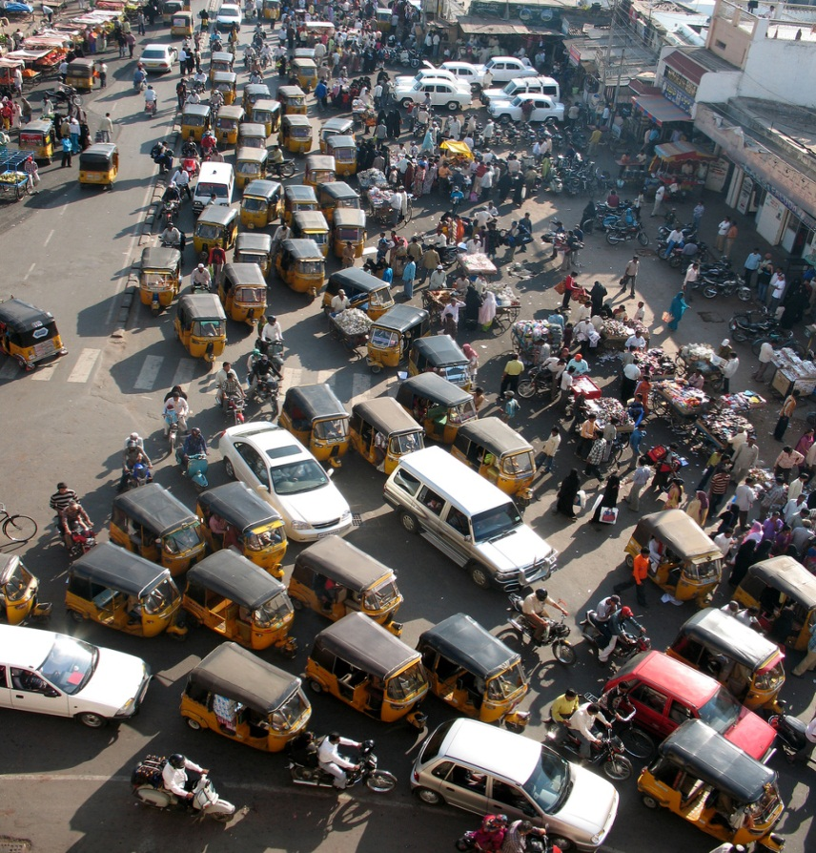
Limitations of Frameworks
Frameworks are powerful, but many app developers fine them hard to create/use effectively
Scope/Commonality/Variability analysis requires significant domain knowledge & reusable software development expertise
Developing frameworks in non-OO languages is even harder
Significant time required to evaluate applicability & quality of a framework for a particular domain
Inversion of control makes debugging tricky
Testing can be tricky due to “late binding”
Performance may degrade due to complex structures & extra levels of indirection
www.dre.vanderbilt.edu/~schmidt/PDF/Queue-04.pdf has more on frameworks
Notes:
http://www.flickr.com/photos/87244355@N00/376781013/

Slide 33


Summary
Don’t apply patterns & frameworks blindly
Abstraction/indirection can increase complexity, cost, & confusion
Notes:
http://www.flickr.com/photos/79029940@N08/8118549381/

Slide 34
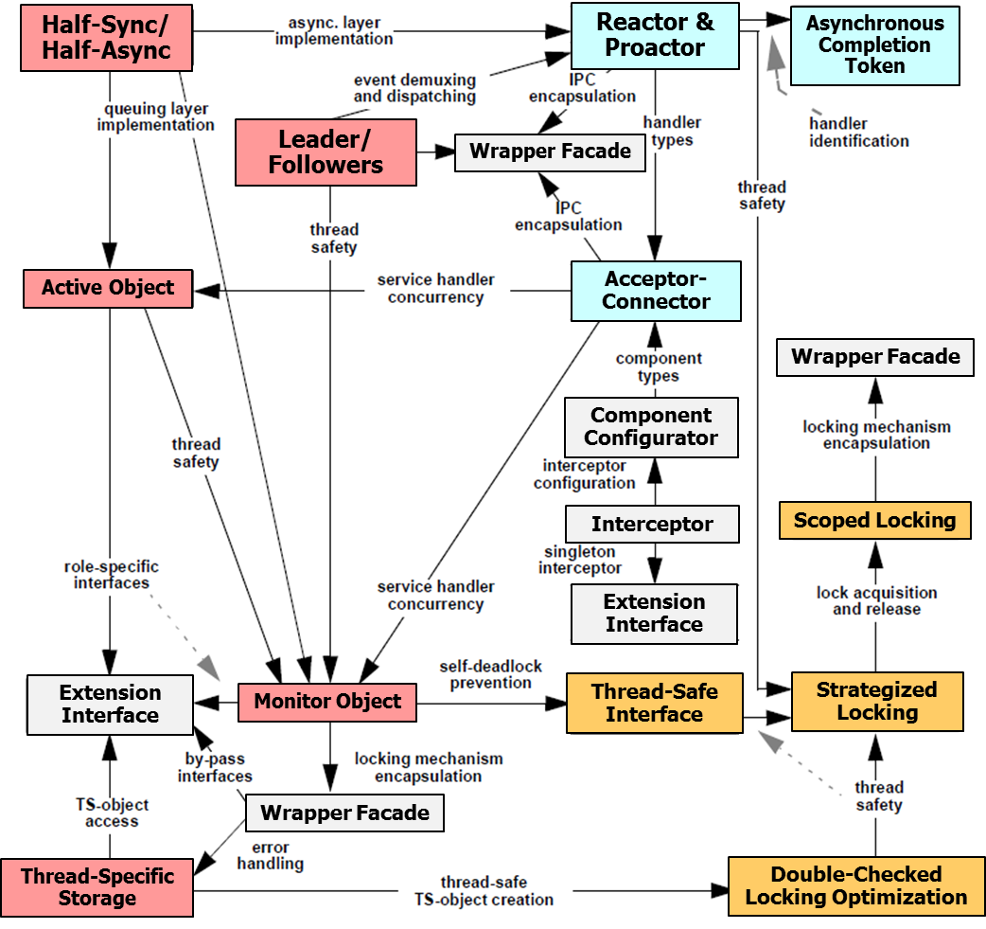
Summary
Don’t apply patterns & frameworks blindly
Abstraction/indirection can increase complexity, cost, & confusion
Understand patterns to learn how to better develop & apply frameworks
Notes:
3D Scales of Justice, http://www.flickr.com/photos/86530412@N02/7953227784/

Slide 35
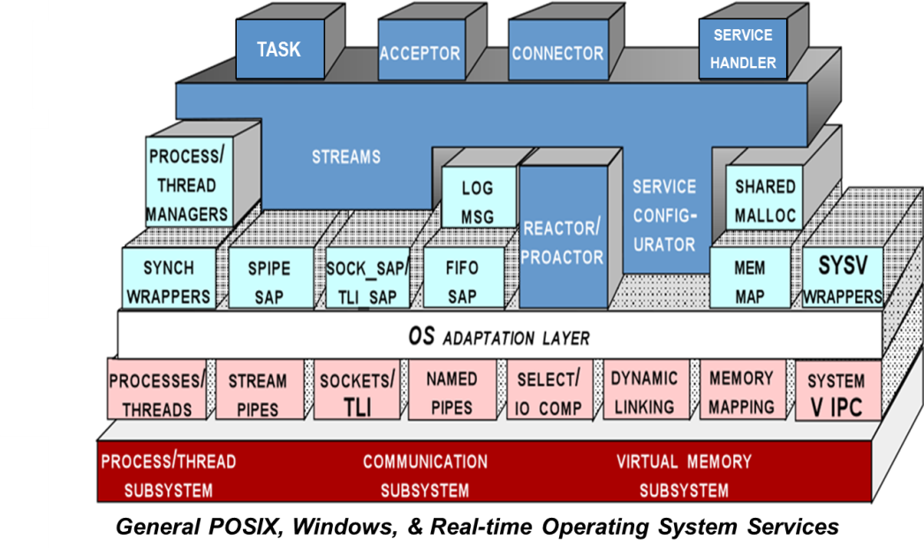
Summary
Don’t apply patterns & frameworks blindly
Abstraction/indirection can increase complexity, cost, & confusion
Understand patterns to learn how to better develop & apply frameworks
Some of the most useful patterns are used to describe frameworks
See www.dre.vanderbilt.edu/~schmidt/patterns-ace.html for more info
Notes:
3D Scales of Justice, http://www.flickr.com/photos/86530412@N02/7953227784/

Slide 36
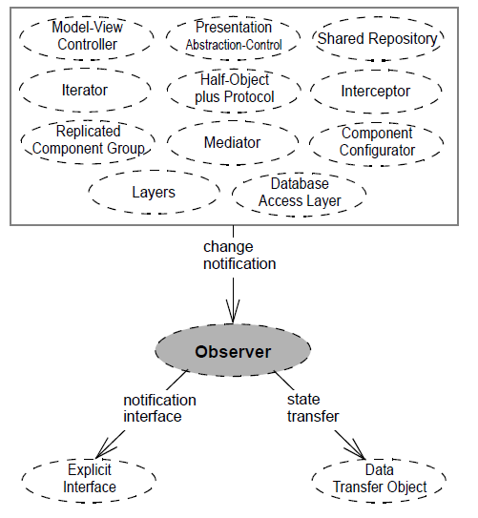
Summary
Don’t apply patterns & frameworks blindly
Abstraction/indirection can increase complexity, cost, & confusion
Understand patterns to learn how to better develop & apply frameworks
Some of the most useful patterns are used to describe frameworks
Patterns can be viewed as abstract descriptions of frameworks that enable broad reuse of software architecture
Notes:
3D Scales of Justice, http://www.flickr.com/photos/86530412@N02/7953227784/

Slide 37
Summary
Don’t apply patterns & frameworks blindly
Abstraction/indirection can increase complexity, cost, & confusion
Understand patterns to learn how to better develop & apply frameworks
Some of the most useful patterns are used to describe frameworks
Patterns can be viewed as abstract descriptions of frameworks that enable broad reuse of software architecture
Frameworks can be seen as concrete realizations of patterns that facilitate direct reuse of design & code
Notes:
3D Scales of Justice, http://www.flickr.com/photos/86530412@N02/7953227784/

Slide 38

Summary
Don’t apply patterns & frameworks blindly
Abstraction/indirection can increase complexity, cost, & confusion
Understand patterns to learn how to better develop & apply frameworks
Some of the most useful patterns are used to describe frameworks
Patterns can be viewed as abstract descriptions of frameworks that enable broad reuse of software architecture
Frameworks can be seen as concrete realizations of patterns that facilitate direct reuse of design & code
Pattern & framework design is even harder than OO design!
Many frameworks limitations can be addressed with knowledge of patterns
Notes:
http://www.flickr.com/photos/93416311@N00/3863324152/

